Slide 1


Secure Voting Platform using Blockchain
GUIDED BY
Mr. Anantha Koothan ,M.E.,
Assistant Professor
CSE DEPARTMENT
BATCH :2024
PROJECT BY
PRATHAP T 311420104051
SANTHOSH KUMAR D 311420104063

Slide 2
OUTLINE
OBJECTIVE
ABSTRACT
PROBLEM STATEMENT
EXISTING SYSTEM
EXISTING SYSTEM ARCHITECTURE
EXISTING SYSTEM LIMITATIONS
PROPOSED SYSTEM
PROPOSED SYSTEM ARCHITECTURE
PROPOSED SYSTEM ADVANTAGES
CLASS DIAGRAM
MODULES
SYSTEM REQUIREMENTS
CONCLUSION
FUTURE ENHANCEMENT
REFERENCES

Slide 3
OBJECTIVE
The objective of this work-in-progress paper is to explore the feasibility and effectiveness of implementing a secure and transparent electronic voting system using blockchain technology.
The paper aims to address the shortcomings of existing voting systems by proposing a novel electronic voting system based on blockchain. It evaluates popular blockchain frameworks to determine their suitability for constructing a blockchain-based e-voting system.
Additionally, the paper seeks to demonstrate the potential of distributed ledger technologies through a case study focused on the electoral process. Ultimately, the objective is to improve the security, transparency, and cost-effectiveness of hosting nationwide elections by leveraging blockchain as a service.

Slide 4
ABSTRACT
Building a secure electronic voting system that offers the fairness and privacy of current voting schemes, while providing the transparency and flexibility offered by electronic systems has been a challenge for a long time.
In this work-in-progress paper, we evaluate an application of blockchain as a service to implement distributed electronic voting systems.
The paper proposes a novel electronic voting system based on blockchain that addresses some of the limitations in existing systems and evaluates some of the popular blockchain frameworks for the purpose of constructing a blockchain-based e-voting system.
In particular, we evaluate the potential of distributed ledger technologies through the description of a case study; namely, the process of an election, and the implementation of a blockchain-based application, which improves the security decreases the cost of hosting a nationwide election.

Slide 5
LITERATURE SURVEY
Sr No. | Name Of paper | Techniques
1 | Blockchain-Based E-Voting System in 2018 Friðrik Þ. Hjálmarsson, Gunnlaugur K. Hreiðarsson, Mohammad Hamdaqa, Gisli Hjalmtysson. | AES Alogrithm
2 | Blockchain based e-voting system in 2022. Akshay Mendon, Bhavya Manoj Votavat, Anirudh Lodh. | Cryptographic verification Homomorphic encryption
3 | E – Voting Using Blockchain in 2023. Suganthi N , Gokul S , Shravanth E , Veena K. | Quprum Geth : Go etherum

Slide 6
EXISTING SOLUTION
The existing paper-based voting system, while historically trusted, is prone to errors and logistical challenges.
Digital voting presents an opportunity to modernize and streamline the electoral process. However, ensuring the security of digital voting systems is paramount due to the potential for cyber threats and manipulation.
Current digital voting systems employ encryption, authentication, and audit trails to mitigate these risks. Yet, concerns persist about the vulnerability of centralized systems to cyberattacks.
The transition to digital voting offers increased accessibility and efficiency but must prioritize the integrity and confidentiality of votes. As technology evolves, addressing security concerns will be crucial in maintaining trust and legitimacy in democratic elections.

Slide 7
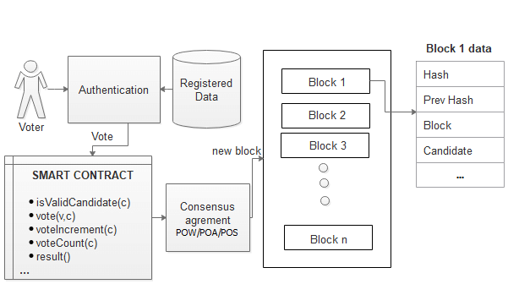
EXISTING SYSTEM ARCHITECTURE

Slide 8
LIMITATIONS OF EXISTING SYSTEM
The existing paper-based voting system faces significant limitations, including susceptibility to errors, logistical challenges, and vulnerability to fraud. Manual processes inherent in paper-based systems lead to inaccuracies in ballot handling, distribution, and counting, while managing large-scale elections introduces logistical hurdles and delays.
The reliance on manual counting further extends the time required to announce results, fostering uncertainty and disputes. Transitioning to digital voting systems addresses these shortcomings, offering increased accuracy, efficiency, and accessibility. Despite facing cybersecurity and privacy concerns, the benefits of digital voting outweigh those of the paper-based system, making its evolution imperative for modernizing and ensuring the integrity of democratic elections.

Slide 9
PROPOSED SYSTEM
In our proposed electronic voting system leveraging blockchain technology, MetaMask is integrated to bolster security and user interaction. MetaMask serves as a digital wallet and browser extension, ensuring secure access to the voting platform. Through MetaMask's authentication mechanism, only authorized users can securely cast their votes, enhancing the system's integrity.
MetaMask facilitates seamless interaction with the blockchain, enabling voters to securely submit their votes and ensuring their transparent and immutable recording on the distributed ledger. This integration not only enhances the security and privacy of the voting process but also provides voters with the ability to independently verify the integrity of the electoral process by accessing the blockchain directly through MetaMask.
By incorporating MetaMask into our blockchain-based electronic voting system, we aim to provide a user-friendly and secure platform that maintains the privacy and fairness of traditional voting systems while leveraging the transparency and flexibility offered by blockchain technology.

Slide 10
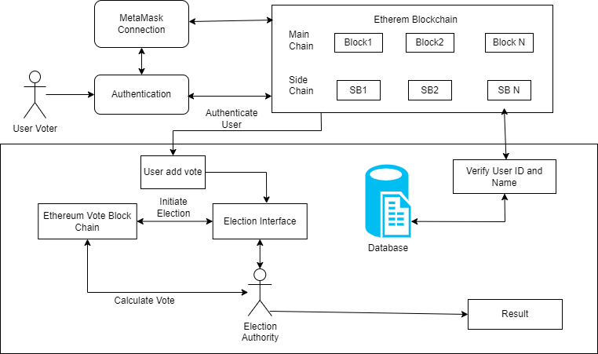
PROPOSED SYSTEM ARCHITECTURE
OTP
Admin

Slide 11
ADVANTAGES FOR PROPOSED SYSTEM
Integrating MetaMask into our blockchain-based electronic voting system enhances security, transparency, and accessibility. MetaMask's authentication mechanism ensures only authorized users can securely cast votes, bolstering system integrity.
Seamless interaction with the blockchain allows for transparent and immutable recording of votes, enabling voters to independently verify the electoral process.
Additionally, MetaMask's user-friendly interface simplifies the voting process, increasing accessibility for all voters. Overall, this integration improves the fairness and reliability of the electronic voting system while leveraging the benefits of blockchain technology.

Slide 12
SYSTEM REQUIREMENTS
HARDWARE REQUIREMENTS
processor : Intel i3 11th Generation or above
OS : Windows 10
RAM : 8GB
SOFTWARE REQUIREMENTS
Software : Node js, React
Software Tools : Visual studio build tools
Language : Html, css, javascript

Slide 13
MODULES
Blockchain Network Emulator (Ganache)
Blockchain Network Interface (MetaMask)
Voter
Administrator
Email OTP Dispatcher(Nodemailer)
Front-end Development (HTML, CSS, JavaScript)
Back-end Implementation (Next.js)

Slide 14
MODULE 1
Blockchain Network Emulator (Ganache)
Ganache is a tool in the Truffle Suite for Ethereum development, creating a private blockchain on a local machine. It's used for deploying contracts, building DApps, and testing without a live Ethereum network. It offers quick setup, account management, a block explorer, and customizable settings, ideal for developing and testing decentralized voting system smart contracts efficiently.

Slide 15
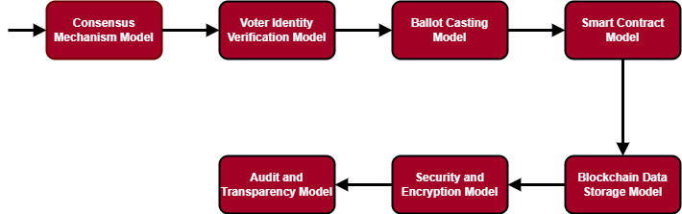
MODULE 1 DIAGRAM

Slide 16
MODULE 1 - ALGORITHM
Step 1 : Network participants agree on transaction validity. Utilize PoW, PoS, DPoS, etc., for agreement.
Step 2 : Verify voter eligibility through biometrics, IDs, cryptography.
Step 3 : Enforce voting rules using smart contracts.Automate tallying in a transparent manner.
Step 4 : Store vote data securely, immutably, and decentralized on the blockchain.
Step 5 : Verify vote integrity and ensure accurate results.

Slide 17
MODULE 2
Blockchain Network Interface (MetaMask)
MetaMask simplifies Ethereum blockchain interactions with a user-friendly interface, supports custom networks and DeFi, ensures privacy and security with password protection and encrypted data storage, and offers seed phrase backup for a seamless experience.

Slide 18
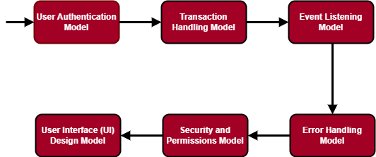
MODULE 2 DIAGRAM

Slide 19
MODULE 2 - ALGORITHM
Step 1 : Ensure secure login and identity verification.
Step 2 : Handle creation, signing, and submission of transactions (votes) via MetaMask.
Step 3 : Provide clear and informative messages to users via MetaMask interface.
Step 4 : Ensure only authorized users access the voting system via MetaMask.
Step 5 : Design user-friendly interface within MetaMask for voting.

Slide 20
MODULE 3
Voter
The user module is the interface for voters in our voting system. It lets them cast votes, see candidate lists and election results securely. It includes authentication for authorized access and user-friendly interfaces for a smooth voting experience. Users play a vital role in the transparent and secure decentralized voting system, with intuitive navigation and real-time updates for engagement and transparency.

Slide 21
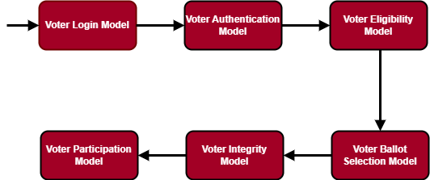
MODULE 3 DIAGRAM

Slide 22
MODULE 3 - ALGORITHM
Step 1 : Validate registrations and ensure only eligible individuals participate.
Step 2 : Authenticate voters accessing the system using various methods.
Step 3 : Verify eligibility before allowing participation in elections.
Step 4 : Protect voter anonymity and prevent unauthorized access to the system.

Slide 23
MODULE 4
Administrator
The admin module manages administrative functions in the voting system. It includes tools for candidate registration, voter authentication, and election monitoring. Features like real-time analytics, audit trails, and role-based access control help administrators make informed decisions and ensure voting process integrity. They can configure parameters, set timelines, and generate detailed reports on voter turnout and outcomes.

Slide 24
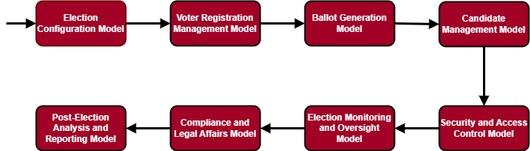
MODULE 4 DIAGRAM

Slide 25
MODULE 4 - ALGORITHM
Step 1 : Set up parameters such as voting dates, eligible candidates, and ballot formats.
Step 2 : Process registration applications and ensure accuracy of voter rolls.
Step 3 : Manage candidate registration, verification, and campaign activities.
Step 4 : Analyze election data and evaluate effectiveness of procedures.

Slide 26
MODULE 5
Email OTP Dispatcher(Nodemailer)
Nodemailer sends secure emails for account verification, password reset, and notifications in the decentralized voting system. It integrates with user authentication, generating unique OTPs or verification links for secure identity authentication. Nodemailer supports customizable email templates, branding, and localization for personalized messages. It also offers robust error handling, delivery tracking, and SMTP server configuration for reliable email delivery.

Slide 27
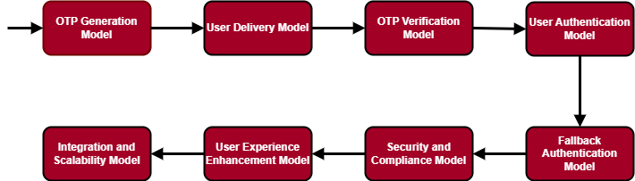
MODULE 5 DIAGRAM

Slide 28
MODULE 5 - ALGORITHM
Step 1 : Generate unique, securely generated OTPs with limited validity periods.
Step 2 : Compose and send emails containing OTPs to users' email addresses.
Step 3 : Validate OTPs against those generated and sent to users.
Step 4 : Protect users' email addresses and data privacy.
Step 5 : Ensure scalability to handle large numbers of users during peak voting periods.

Slide 29
MODULE 6
Front-end Development (HTML, CSS, JavaScript)
The frontend of the decentralized voting system uses HTML for structure, CSS for styling and animations, and JavaScript for interactivity. It prioritizes accessibility, mobile responsiveness, and cross-browser compatibility for a seamless user experience across devices and platforms.

Slide 30
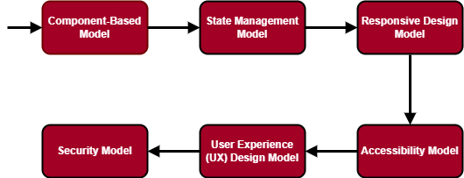
MODULE 6 DIAGRAM

Slide 31
MODULE 6 - ALGORITHM
Step 1 : Implement responsive design techniques for accessibility across devices.
Step 2 : Ensure accessibility features for users with disabilities.
Step 3 : Enhance overall user satisfaction and engagement.
Step 4 : Implement security measures like input validation and HTTPS encryption.

Slide 32
MODULE 7
Back-end Implementation (Next.js)
Next.js powers the backend of the decentralized voting system, handling server-side logic, data management, and external service communication. It's a versatile SSR React framework, optimizing performance and SEO visibility. Next.js API routes, middleware, and serverless functions manage authentication, authorization, and data validation securely. It also supports database integration, session management, and caching for scalable and resilient operations, enabling robust decentralized voting systems.

Slide 33
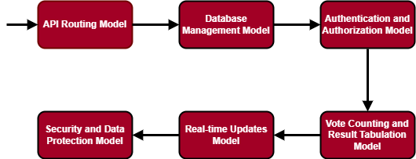
MODULE 7 DIAGRAM

Slide 34
MODULE 7 - ALGORITHM
Step 1 : Verify user credentials and validate JSON Web Tokens (JWT) for authentication.
Step 2 : Provide users with live updates on election status, vote counts, and result announcements.
Step 3 : Implement security measures such as input validation, data encryption, and HTTPS encryption for network communication.

Slide 35
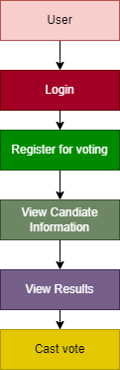
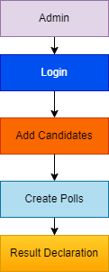
DATA FLOW DIAGRAMS

Slide 36
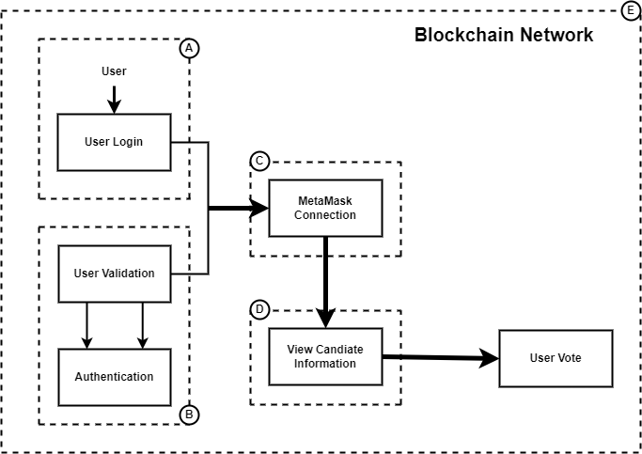
BLOCKCHAIN NETWORK EMULATOR AND INTERFACE DATA FLOW:

Slide 37
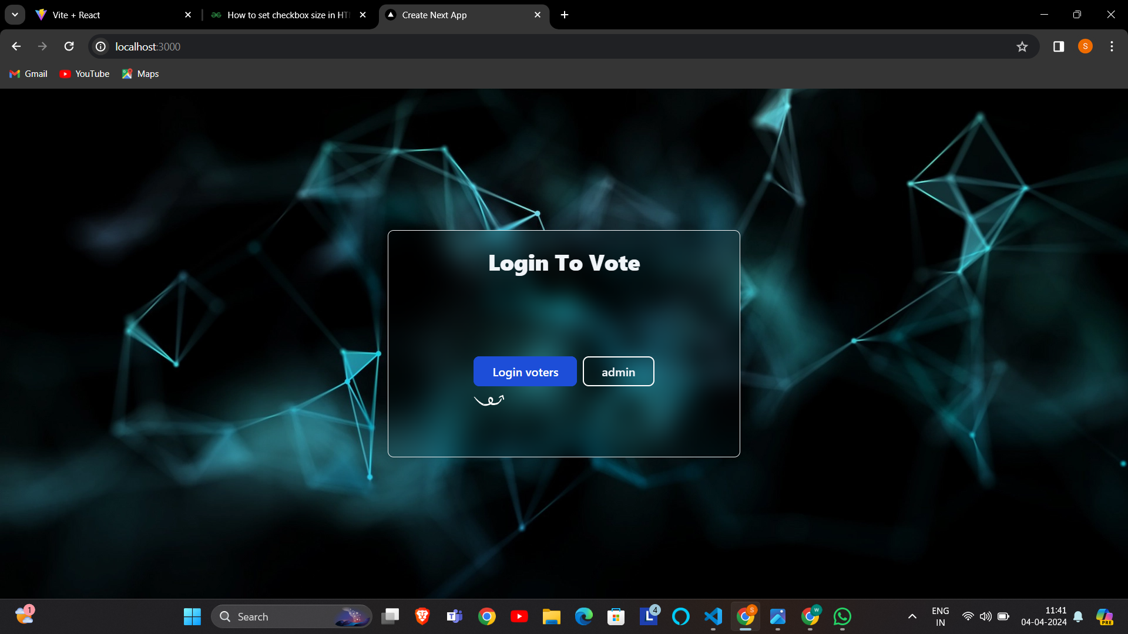
SCREENSHOT OF WORKING SYSTEM

Slide 38
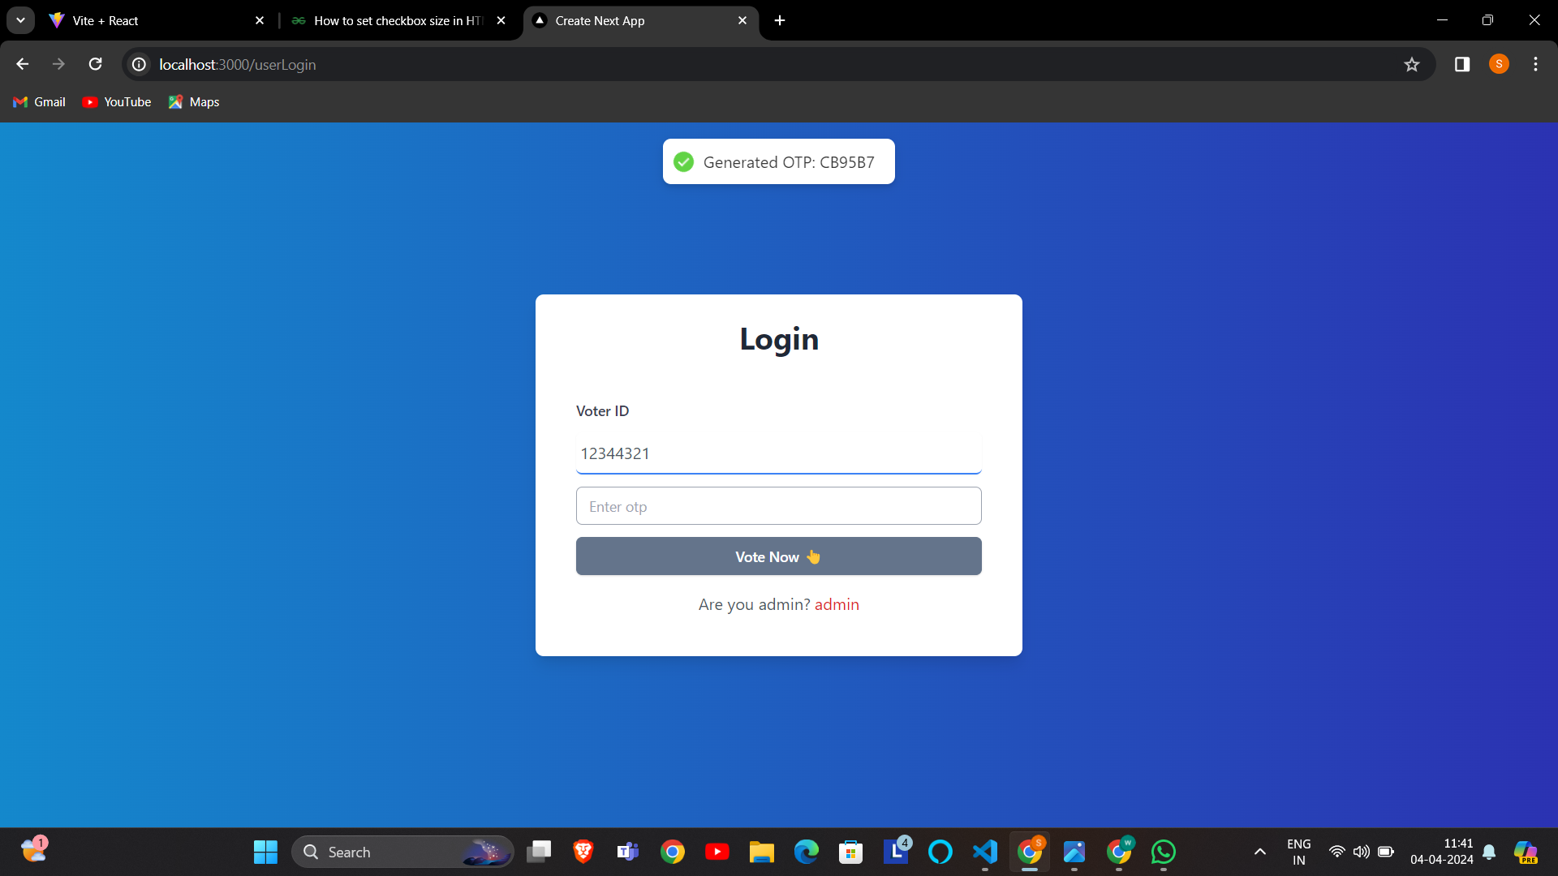

Slide 39
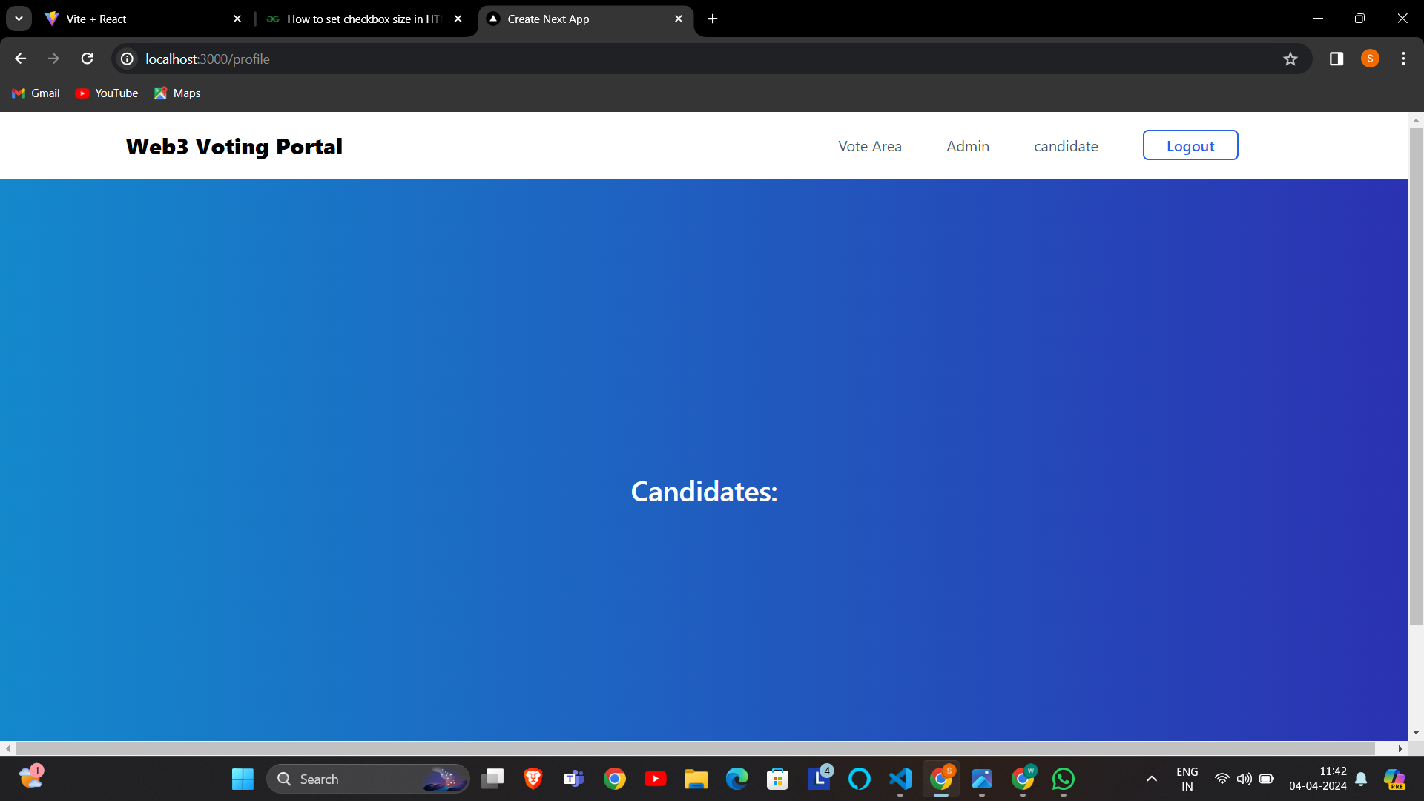

Slide 40
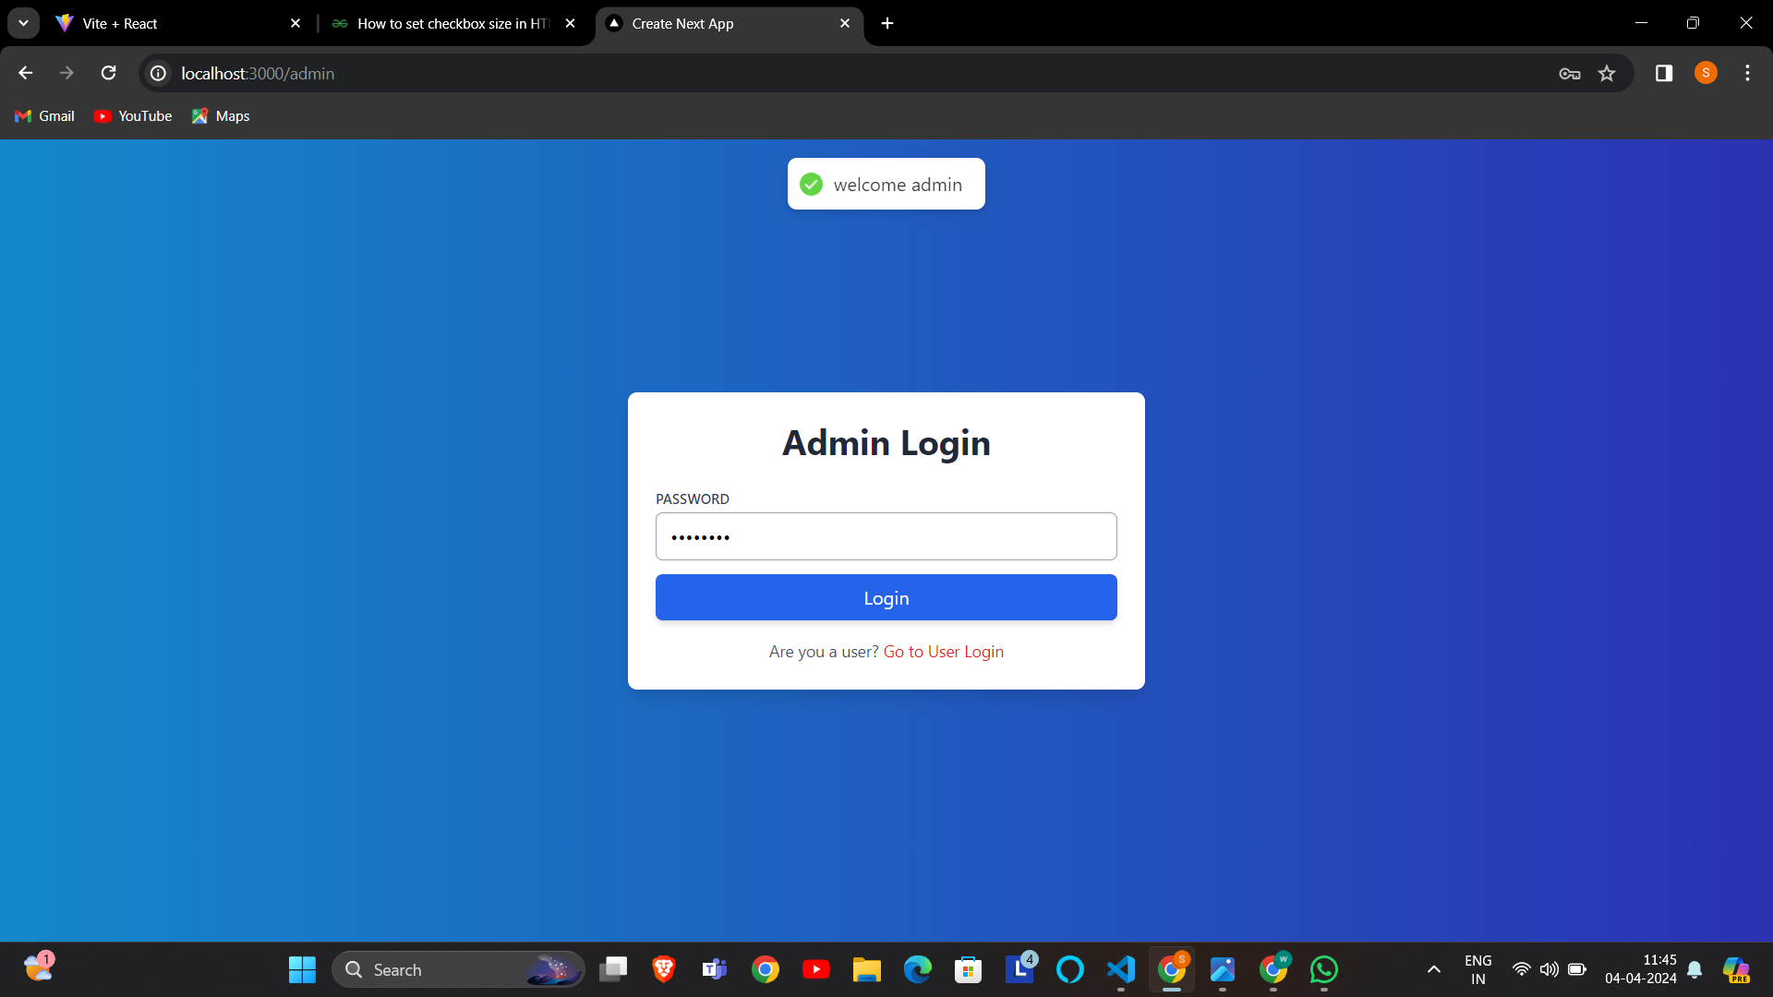

Slide 41
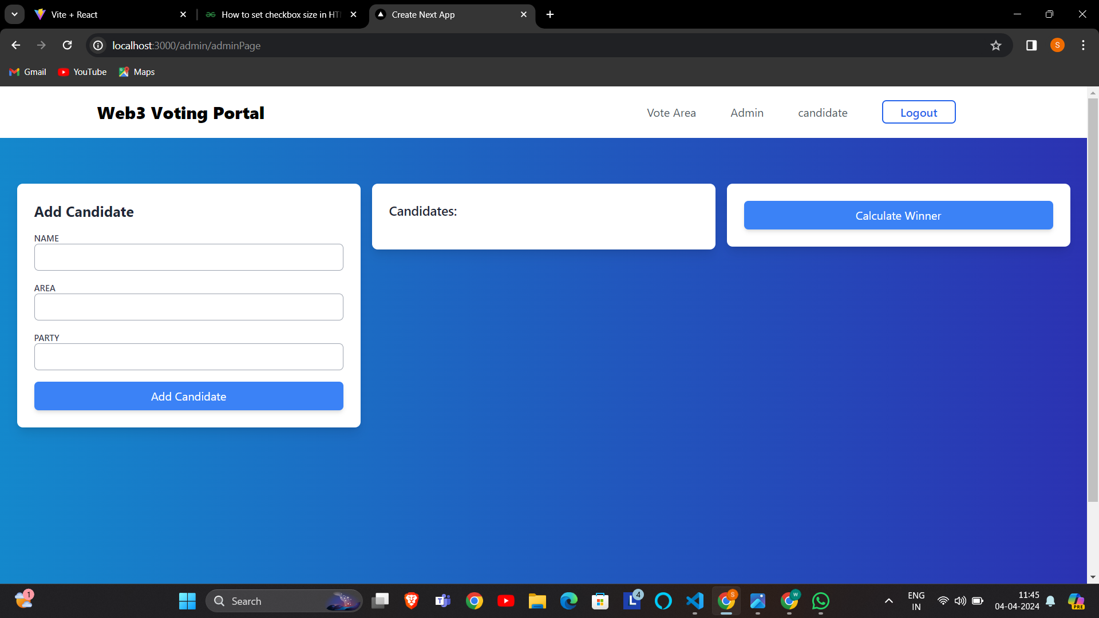

Slide 42
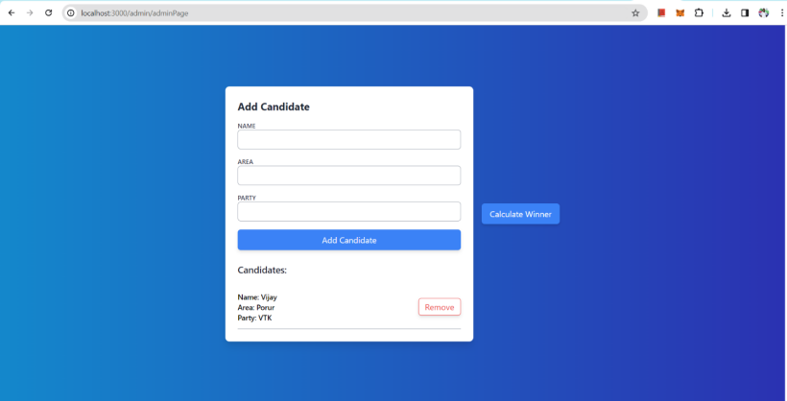

Slide 43
CONCLUSION
A nation with less voting percentage will fight to develop as choosing a right front-runner for the nation is very essential. Our future system is designed to provide a secure data and dependable voting amongst the people of the equality. Block chain itself has been used in the Bitcoin scheme known as the dispersed bank system. By assuming blockchain in the distribution database on voting system one can reduce the double-dealing sources of database management. This project aims to voting effect using blockchain procedure from every place of election

Slide 44
REFERENCE
Gallup, "Trust in Government," Gallup, 30 September 2015. [Online]. Available: http://www.gallup.com/poll/5392/trust-government.aspx. [Accessed 28 Septmeber 2016].
The electoral knowledge network, "Cost of Registration and Elections," ACE Project, 15 Jan 2016. [Online]. Available: http://aceproject.org/ace-en/focus/core/crb/crb03. [Accessed 28 September 2016].
McCorry, P., Shahandashti, S. F. and Hao. F. (2017) A smart contract for boardroom voting with maximum voter privacy in the proceedings of FC 2017

Slide 45
THANK YOU

